Slide 1
Word Meaning and Similarity
Word Similarity: Distributional Similarity (II)

Slide 2
Using syntax to define a word’s context
Zellig Harris (1968)
“The meaning of entities, and the meaning of grammatical relations among them, is related to the restriction of combinations of these entities relative to other entities”
Two words are similar if they have similar parse contexts
Duty and responsibility (Chris Callison-Burch’s example)
Modified by adjectives | additional, administrative, assumed, collective, congressional, constitutional …
Objects of verbs | assert, assign, assume, attend to, avoid, become, breach …

Slide 3
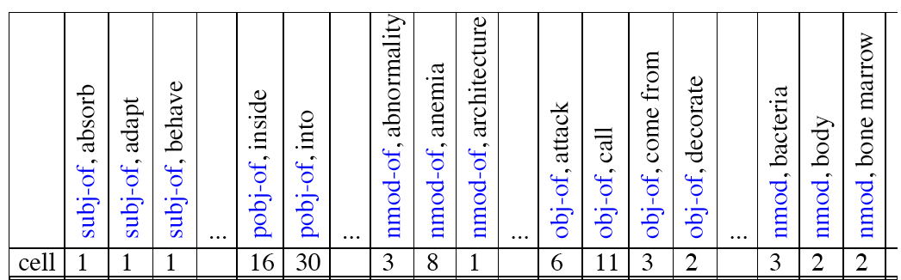
Co-occurrence vectors based on syntactic dependencies
Dekang Lin, 1998 “Automatic Retrieval and Clustering of Similar Words”
The contexts C are different dependency relations
Subject-of- “absorb”
Prepositional-object of “inside”
Counts for the word cell:

Slide 4
PMI applied to dependency relations
Hindle, Don. 1990. Noun Classification from Predicate-Argument Structure. ACL
Object of “drink” | Count | PMI
it | 3 | 1.3
anything | 3 | 5.2
wine | 2 | 9.3
tea | 2 | 11.8
liquid | 2 | 10.5
Object of “drink” | Count | PMI
tea | 2 | 11.8
liquid | 2 | 10.5
wine | 2 | 9.3
anything | 3 | 5.2
it | 3 | 1.3
“Drink it” more common than “drink wine”
But “wine” is a better “drinkable” thing than “it”

Slide 5
Reminder: cosine for computing similarity
Sec. 6.3
Dot product
Unit vectors
v_{i} is the PPMI value for word v in context i
w_{i} is the PPMI value for word w in context i.
Cos(v,w) is the cosine similarity of v and w
Notes:
See Law of Cosines (Cosine Rule) wikipedia page

Slide 6
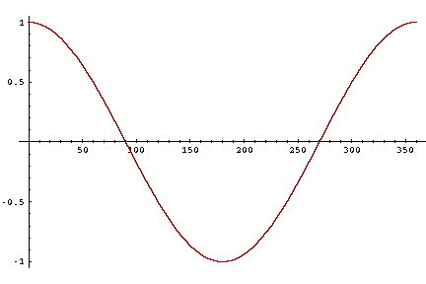
Cosine as a similarity metric
-1: vectors point in opposite directions
+1: vectors point in same directions
0: vectors are orthogonal
Raw frequency or PPMI are non-negative, so cosine range 0-1

Slide 7
 | large | data | computer
apricot | 1 | 0 | 0
digital | 0 | 1 | 2
information | 1 | 6 | 1
Which pair of words is more similar?
cosine(apricot,information) =
cosine(digital,information) =
cosine(apricot,digital) =

Slide 8
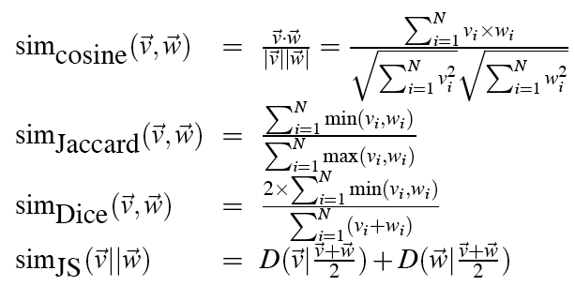
Other possible similarity measures

Slide 9
Evaluating similarity (the same as for thesaurus-based)
Intrinsic Evaluation:
Correlation between algorithm and human word similarity ratings
Extrinsic (task-based, end-to-end) Evaluation:
Spelling error detection, WSD, essay grading
Taking TOEFL multiple-choice vocabulary tests
Levied is closest in meaning to which of these:
imposed, believed, requested, correlated

Slide 10
Word Meaning and Similarity
Word Similarity: Distributional Similarity (II)

